Slide 1
Spring MVC

Slide 2
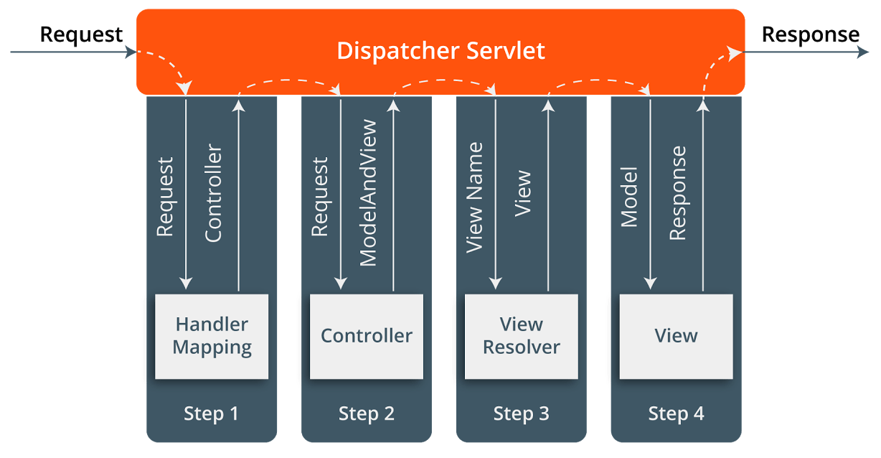
Spring- Model View Controller
Notes:
Spring MVC helps in building flexible and loosely coupled web applications. The Model-View-Controller design pattern helps in separating the business logic, presentation logic and navigation logic. It provides an elegant solution to use MVC in Spring Framework with the help of DispatcherServlet.

Slide 3
Spring - MVC
When a request is sent to the Spring MVC Framework the following sequence of events happen.
The DispatcherServlet first receives the request.
The DispatcherServlet consults the HandlerMapping and invokes the Controller associated with the request.
The Controller processes the request by calling the appropriate service methods and returns a ModelAndView object to the DispatcherServlet. The ModelAndView object contains the model data and the view name.
The DispatcherServlet sends the view name to a ViewResolver to find the actual View to invoke.
Now, the DispatcherServlet will pass the model object to the View to render the result.
The View, with the help of the model data, will render the result back to the user.

Slide 4
Spring MVC
Hello World Example

